Slide 1
3. COMPOSITE VIDEO SIGNAL
Prepared by
Sam Kollannore U.
Lecturer, Department of Electronics M.E.S.College, Marampally, Aluva-7

Slide 2
COMPOSITE VIDEO SIGNAL
Consist of :
Camera signal - corresponding to the desired picture information
Blanking pulses – to make the retrace invisible
Synchronizing pulses – to synchronize the transmitter and receiver scanning
-horizontal sync pulse
-vertical sync pulse
-their amplitudes are kept same
-but their duration are different
-needed consecutively and not simultaneously with the picture signal – so sent on a time division basis

Slide 3
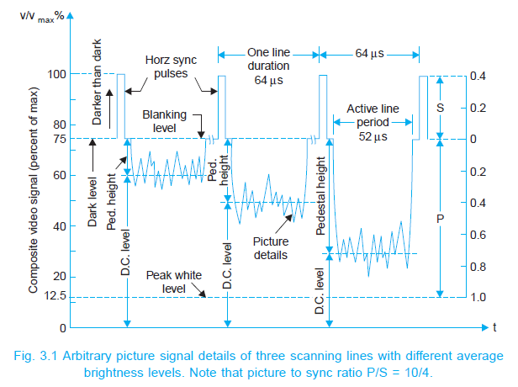
Composite Video Signal …contd

Slide 4
Composite video signal …contd
Video signal varies between certain limits
Peak white level: 10 to 12.5%
Black level : 72%
Blanking level : Sync pulses added - 75% level
Pedestal : difference between black level and blanking level – tend to merge
Pedestal height : distance between the pedestal level and the dc level – indicates the average brightness
Picture information : 10% - 75%
Darker the picture – higher will be the voltage within those limits

Slide 5
DC component of the video signal
Average value or dc component corresponding to the average brightness of the scene
Average brightness can change only from frame to frame and not from line to line
Low pedestal height – scene darker
Larger pedestal height – higher average brightness

Slide 6
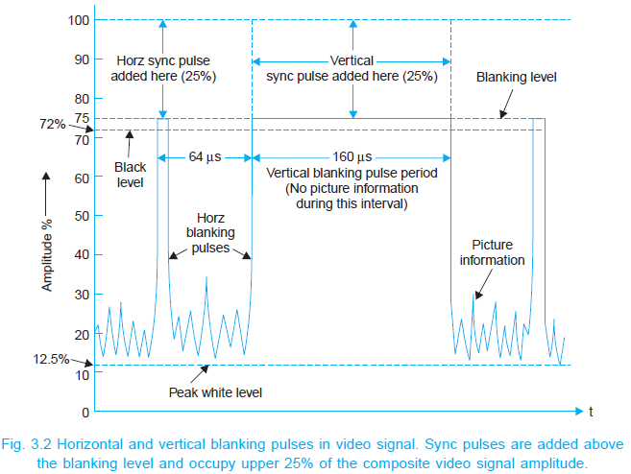
blanking pulses . . .
Make the retrace lines invisible by raising the signal amplitude slightly above the black level (75%)
Repetition rate of horizontal blanking pulse = scanning freq.
= 15625Hz
Freq of vertical blanking pulse = field scanning freq. = 50 Hz

Slide 7
Sync Pulse and Video Signal Amplitude Ratio
P/S RATIO = 10/4
Justification:
If the picture signal amplitude is ↑ at the expense of sync pulses – when S/N ratio at the receiver falls, sync pulse amplitude becomes insufficient to keep the picture locked
If the sync pulse amplitude is ↑ at the expense of the picture signal, then the raster remains locked but the amplitude of the picture content will be too low
P/S ratio of 10/4 represents the most efficient use of TV system

Slide 8
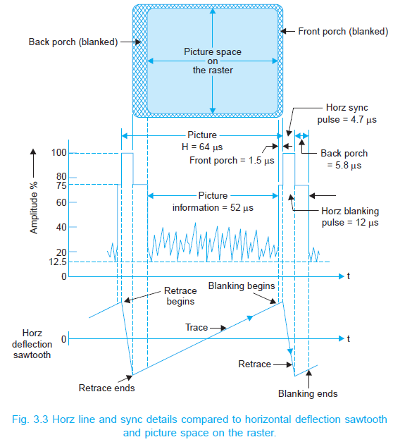
horizontal Sync details . . .

Slide 9
horizontal sync details …contd
Total line period = 64µS
Line blanking period = 12µS
Differential leading edges are used for synchronizing horizontal scanning oscillator
Divided into three sections :
front porch : 1.5µS - allows the receiver video to settle down
line sync : 4.7 µS - for blanking the flyback/retrace
- blacker than the black
back porch : 5.8µS - time for the horizontal time base circuit to reverse the direction of current for scanning the next line
- same amplitude as that of blanking level ; used by AGC circuits at the receiver to develop true AGC voltage

Slide 10
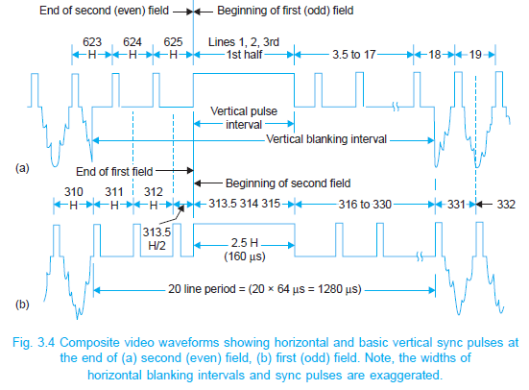
Vertical Sync details

Slide 11
Vertical Sync details …contd.
Added after each fields
Complex in nature
Vertical sync period = 2.5 to 3 times the horizontal line period
In 625 line system: 2.5 × 64 = 160µS
Commence at the end of first half of 313th line (end of first field) and terminates at the end of 315th line
Similarly after an exact interval of 20mS (one field period), the next sync pulse occupies the line numbers 1st, 2nd and first half of 3rd .

Slide 12
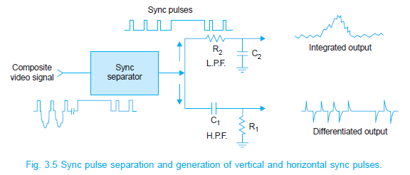
Vertical sync details …contd
Horizontal sync information is extracted from the sync pulse train by differentiation i.e. Passing the pulse train through an HPF – leading edges are used to synchronize the horizontal scanning oscillator
Furthermore, receivers often use monostable multivibrators to generate horizontal scan, and so a pulse is required to initiate each and every cycle of the horizontal oscillator in the receiver.

Slide 13
Shortcomings and its solution
1. Horizontal sync pulses are available both during the active and blanked line periods but there are no sync pulses (leading edges) available during the 2.5 line vertical sync period – horizontal sweep oscillator would tend to step out of synchronism during each vertical sync period
The situation after an odd field is even worse
-since it begins at midway
-leading edge of the vertical sync pulse comes at the wrong time to provide synchronism for the horizontal oscillator
Therefore five narrow slots (4.7µS width) are cut in the vertical sync pulse at intervals of 32µS – rising edges are used to trigger horizontal oscillator.
This insertion of short pulses : called notching of serration of the broad field pulses

Slide 14
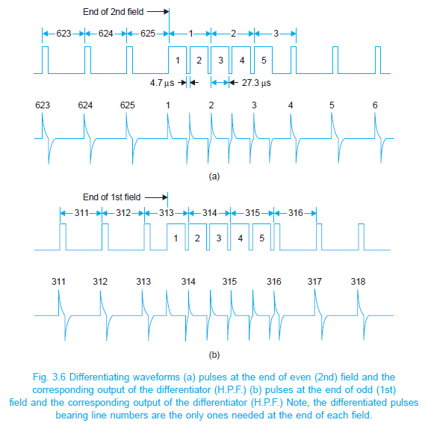
Shortcomings and its solution ….contd
notching of serration of the broad field pulses
notching of serration of the broad field pulses

Slide 15
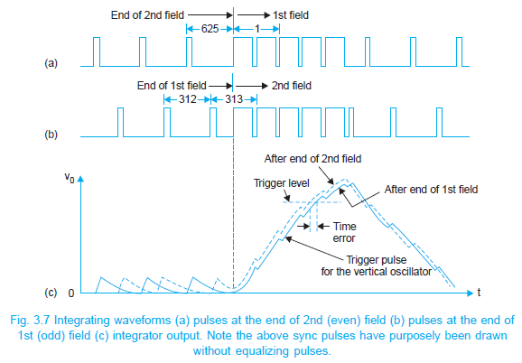
Shortcomings and its solution ….contd
2. It is seen that the synchronization of the vertical sweep oscillator in the receiver is obtained from vertical sync pulses by integrator (LPF)
Voltage built across the capacitor of the LPF corresponding to the sync pulse trains of both the fields is shown in fig.

Slide 16
Shortcomings and its solution ….contd
Each horizontal pulse cause a slight rise in voltage across the capacitor, but this is reduced to zero by the time the next pulse arrives (charging period=4.7µS and discharging period = 59.3µS)
But during broad serrated region, capacitor has more time to charge and only 4.7µS to discharge
Situation is different for the beginning of the 2nd field-here the last horizontal pulse corresponding to the beginning of the 313th line is separated from the first vertical pulse by only half-a-line.
Therefore the voltage developed a/c the vertical filter will not have enough time to reach zero before the arrival of the 1st vertical pulse
Hence the voltage developed a/c the o/p filter is some what higher at each instant as compared to the voltage developed at the beginning of the 1st field (shown as dotted chain)
i.e. Oscillator get triggered a fraction of a second early as compared to the first field - upset the desired interlacing sequence
Equalizing pulses are used to solve this problem

Slide 17
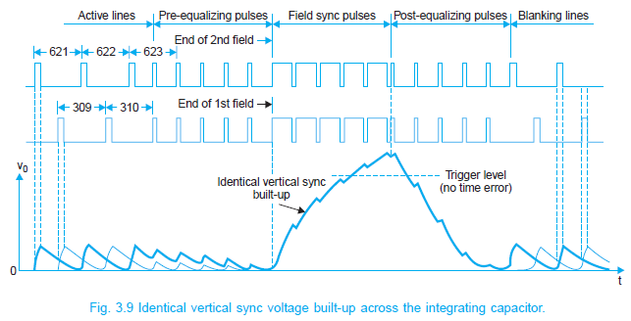
Equalizing pulses
Solves the shortcomings occurring on account of half line discrepancy
Five narrow pulses of 2.5 line period are added on either side of the vertical sync pulses : known as pre-equalizing and post-equalizing pulses
The effect of these pulses is to shift the half line discrepancy away from both the beginning and end of the vertical sync pulses

Slide 18
Equalizing pulses . . . contd
Pre-equalizing pulses:
- 2.3µS duration
- result in the discharge of the capacitor to zero voltage
in both the fields
Post-equalizing pulses: necessary for a fast discharge of the capacitor to ensure triggering of the vertical oscillator at proper time
With the insertion of equalizing pulses:
- the voltage rise and fall profile is the same for both the
field sequences
- the vertical oscillator is triggered at the proper instants.
i.e. exactly at an interval of 1/50th of a second.

